Slide 1
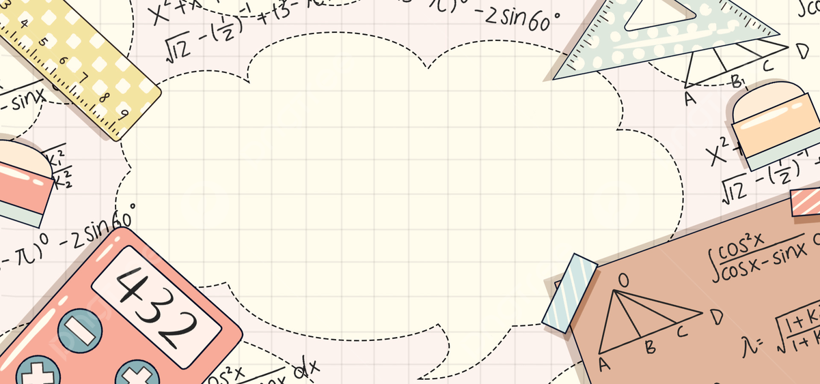

Hand motion based exam Edu-Pad

Slide 2
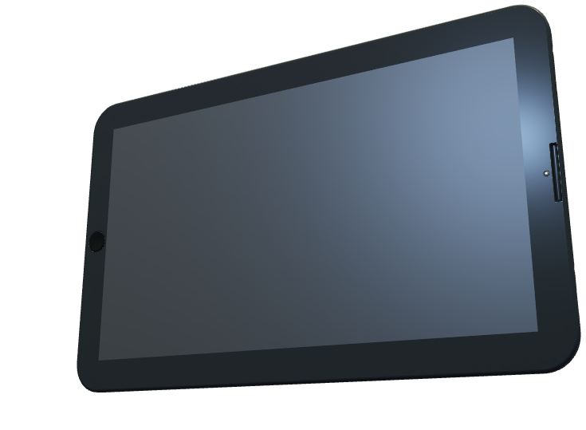
1.Why did we selected that particular problem statement?

Slide 3







Develop a Low-Cost Digital Examination Platform and a device for Inclusive Online Assessments & Digital Learning

Slide 4
Our selection of the problem statement,
"Develop a Low-Cost Digital Examination Platform for Inclusive Online Assessments"
stems from a deep understanding of the critical challenges faced by educational institutions, particularly in rural and economically constrained areas.
Global Education Disparities :
In rural areas, access to quality education is often limited. Our low-cost digital examination platform aims to bridge this gap by providing an affordable and customizable solution.
According to UNESCO, the global education gap has been widening, especially in rural regions where traditional examination methods may not be feasible.
Economic Constraints of Educational Institutions :
Many schools and universities in rural areas face financial constraints, limiting their ability to adopt sophisticated digital examination platforms.
Our affordable solution not only accommodates these economic challenges but also provides a customizable framework that can be tailored to the specific needs of each educational institution

Slide 5
Digital India's Vision:
Our project aligns seamlessly with the vision of Digital India, a flagship program that aims to transform the nation into a digitally empowered society.
By offering an affordable and customizable digital examination platform, we contribute to the overarching goals of Digital India, ensuring that the benefits of technological advancements reach even the most remote corners of the country.
Potential Impact on Rural Education:
The potential impact of our device on rural education is substantial. Its affordability and customizability make it a practical and sustainable solution for schools in remote areas.
The device's adaptability allows for a variety of educational applications beyond examinations, such as interactive learning modules and remote teacher-student engagement

Slide 6
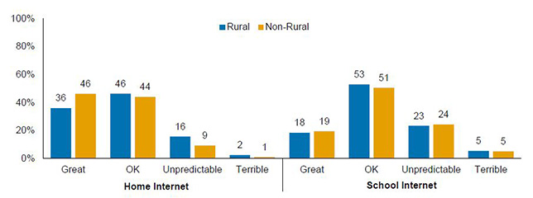
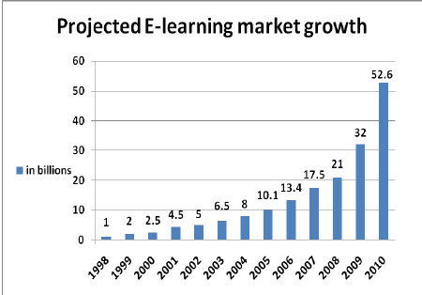
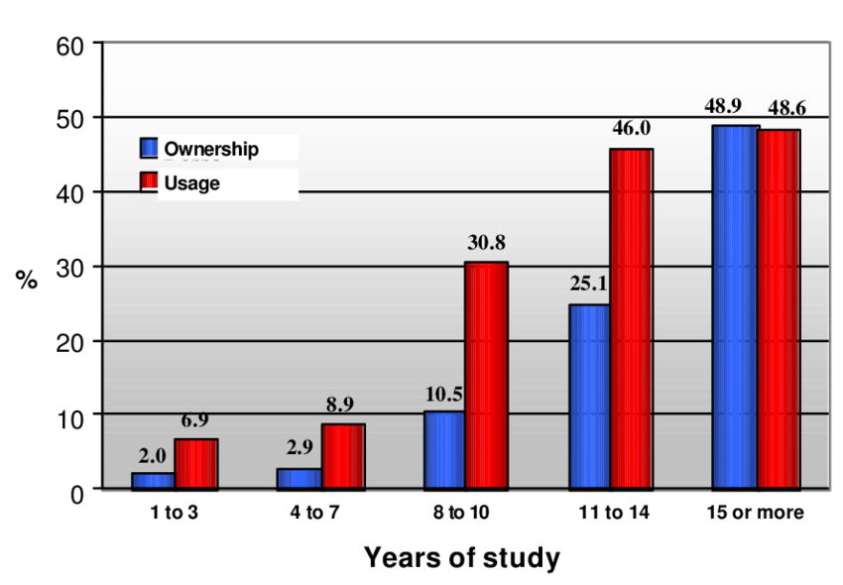
Figures Related to E-Learning
Percentage of people that have and use computers by years of study, in poor communities

Slide 7
2.Our Solution
We are going to develop a hand-motion based digital exam edu-pad and an online platform that can be used by students at the time of examination to write their answer on the digital board instead of pen and paper and can upload to our platform where the teacher can easily access these answer sheets using his/her credentials and can do further copy correction and alot marks to students.

Slide 8
Key Features:
Affordability with Impact:
Hand motion based exam edu-pad is a cost-effective alternative that doesn't compromise on functionality. It provides an inclusive solution for schools and universities with limited budgets, ensuring that quality education is within reach.
Customizable and Adaptable:
Tailoring to the unique needs of diverse educational institutions, our platform offers a high degree of customization From exam formats to user interfaces, Hand motion based exam edu padadapts to the specific requirements of each educational setting
.
Innovation Beyond Exams:
Hand motion based exam edu-pad is not just an examination platform; it's a versatile tool that opens up new possibilities for interactive learning. The hand-gestured virtual hover, powered by OpenCV and deep learning, allows students to engage with educational content in ways never seen before.

Slide 9
.
Bridge the Rural-Urban Education Divide:
With a focus on rural education, Hand motion based exam edu-pad is a bridge across the digital divide. Students in remote areas can now have access to a state-of-the-art examination platform without the need for expensive touch screen devices.
Digital Empowerment:
Inspired by the Digital India initiative, our solution aligns with the vision of creating a digitally empowered society. By making motion-sensing technology accessible through non-touch devices like laptops and mobile phones, Hand motion based exam edu-pad opens doors to a new era of remote learning

Slide 10

Impact and Vision:
The potential impact of Hand motion based exam edu padextends beyond exams; it envisions a future where education is not bound by geographical or economic constraints. By democratizing access to advanced learning technologies, we aim to foster a new era of inclusive education where every student, regardless of their background, can thrive.
In conclusion, Hand motion based exam edu padis not just a solution to a problem statement; it's a catalyst for positive change in the education sector. Join us on this journey as we redefine examinations, empower educators, and transform the educational landscape for generations to come. Hand motion based exam edu pad— Shaping the Future of Learning.

Slide 11

3.Correlation between the problem and the solution

Slide 12
.
The correlation between the problem statement, "Develop a Low-Cost Digital Examination Platform for Inclusive Online Assessments," and our solution, Hand motion based exam edu pad, is rooted in a strategic alignment that directly addresses the challenges identified in the education sector.
Affordability and Accessibility:
Problem Statement: Educational institutions, especially in rural areas, face financial constraints, limiting their ability to adopt expensive digital examination platforms.
Solution: Hand motion based exam edu-pad offers an affordable alternative that is designed with the economic challenges of educational institutions in mind. Its low-cost nature ensures that even schools with limited budgets can implement a sophisticated digital examination system

Slide 13
Customizability to Diverse Needs:
Problem Statement: Educational institutions have unique requirements, and a one-size-fits-all solution may not be practical
Solution: Py-Digital's high degree of customizability addresses this concern. It is adaptable to various educational settings, allowing institutions to tailor the platform to their specific needs ensuring a seamless integration with existing systems.
Versatility Beyond Examinations:
Problem Statement: Traditional examination platforms may serve a single purpose and lack versatility.
Solution: Hand motion based exam edu-pad goes beyond exams, introducing a hand-gestured virtual hover for interactive learning.
This versatility transforms the platform into a dynamic educational tool, fostering engagement and providing a holistic learning experience.

Slide 14
Digital Empowerment and Inclusivity:
Problem Statement: The digital divide poses a barrier to inclusive education, limiting access to advanced learning technologies.
Solution: Hand motion based exam edu padaligns with the vision of Digital India by making motion-sensing technology accessible through non-touch devices. This not only addresses the digital divide but also empowers students in rural areas, ensuring they have equal opportunities for quality education.
Remote Learning and Cost-Effective Technology:
Problem Statement: Remote learning faces challenges, especially in economically constrained environments.
Solution: Hand motion based exam edu-pad facilitates remote learning by allowing students to use their non-touch laptops or mobile phones as motion-sensing devices. This cost-effective approach ensures that students can participate in online assessments with minimal expenditure, contributing to a smoother online teaching-learning process.

Slide 15
Summary of Corelation
In summary, the correlation between the problem statement and Hand motion based exam edu-pad lies in its ability to provide a comprehensive and strategic solution. Hand motion based exam edu-pad directly addresses the financial, technological, and accessibility challenges outlined in the problem statement, offering a transformative platform that not only solves the problem at hand but also opens doors to a new era of inclusive and affordable education.

Slide 16
4.APPLICATION

Slide 17
Educational Institutions:
Affordable examination platform for schools and universities.
Customizable to diverse educational settings.
Rural Education:
Bridges the digital divide in remote areas.
Enables affordable and advanced learning technologies.
Digital India Initiative:
Aligns with the vision of Digital India for a digitally empowered society.
Inclusive Online Assessments:
Provides equal opportunities for quality education.
Supports a diverse range of students.
Versatile Learning Tool:
Goes beyond exams with interactive learning modules.
Enhances student engagement and participation.

Slide 18
Remote Learning:
Allows the use of non-touch laptops or mobile phones.
Facilitates online teaching-learning in economically constrained environments
.
Cost-Effective Technology:
Low-cost solution for institutions with limited budgets.
Minimizes expenditure for students in remote areas.

Slide 19
5.FUTURE SCOPE

Slide 20

Future Scope and Plans (Our X-Factor)
Railway Ticket Booking :
Human-Robot Interaction:
Communication Device for Deaf, Blind and Dumb:

Slide 21
NOVELITY
Stylus-Free Operation:-
No need for a stylus, making the device more accessible and user-friendly.
Universal Symbol and Language Support:-
Allows users to write in any symbol or language directly on the screen.
Real-time Auto-Correction and Suggestions:-
Features automatic correction and real-time suggestions as users write.
4. Python Open Source Software:-
Built using open-source Python, promoting transparency and flexibility.
Stand-Alone Project:-
Operates independently without requiring external screens, software, or canvases.
Cost-Effective Design:-
Excludes touchpad components, reducing overall production costs.

Slide 22

Expanded Market Potential:
Tap into the growing online education industry, targeting a vast market of educators and institutions, especially in India.
Proctored Exam Solutions:
Provide economical and effective tools for universities transitioning to online exams, capitalizing on the demand for proctored test solutions.
Enhanced Presentation Capabilities:
Evolve Hand motion based exam edu-pad into a comprehensive presentation tool, catering to educators who rely on interactive classes and dynamic content.

Slide 23

Continuous Product Improvement:
Implement a strategy for regular updates and enhancements, ensuring the device remains technologically competitive and user-friendly.
Broader User Segmentation:
Expand the user base to include digital artists, researchers, and academicians, offering a versatile tool for various industries.
Integration with Online Platforms:
Explore partnerships with popular online education platforms, enhancing the compatibility and accessibility of Hand motion based exam edu-pad

Slide 24
Cost-Effective Solutions for General Public:
Leverage the absence of touch screen processors to maintain affordability, making the device accessible to a wide range of consumers.
8. Collaboration with Educational Institutions:
Establish collaborations with colleges and universities, providing tailored solutions for educators and students engaged in online learning.
9. Adoption of Emerging Technologies:
Stay abreast of emerging technologies in the education sector and integrate them into Hand motion based exam edu-pad for continuous innovation.
10. Global Reach:
Explore opportunities for international expansion, targeting a broader global market beyond the current focus on India.

Slide 25





Team I-Leaves
Subhadeep Ghorai Python Developer Member
Anshul Ojha Full Stack Developer Member
Adarsh Singh Python Developer Lead
Tapon Ray Python Developer Member

Slide 26



THANK YOU

